Slide 1

Student Performance Analysis & Efficiency Prediction: Colombian Engineering Students
Our multi-phase project analyzes and predicts efficiency using academic data from Colombian engineering students. We explored, measured, and modeled student performance for better educational support.

Slide 2





Project Overview & Objectives
We aimed to analyze and predict student efficiency among engineering students in Colombian universities. Our objective was to identify patterns in student performance and build a model to support early intervention for students at risk.
Data Exploration
Conducted exploratory data analysis to understand student records.
Clustering
Group students by performance using unsupervised learning.
Efficiency Evaluation (TOPSIS)
Assess how effectively students used their academic resources.
Classification Modeling
Predict efficiency status using supervised learning.
Deployment
Deliver insights through an interactive Streamlit app.

Slide 3






Data Collection & Preprocessing
We used academic performance data of engineering students from Colombian universities, including high school scores, standardized test results, and university performance metrics.
Data Source
Removal of Synthetic Data
Data Cleaning
We used real academic data of engineering students from Colombian universities, including high school scores, standardized tests, and university performance indicators.
Initially, we worked with generated data that led to misleading results. We later replaced it with real data to ensure reliability.
We handled missing values, removed duplicates, and fixed inconsistent entries to prepare the dataset for analysis.
Feature Engineering
Feature Scaling
Outlier Detection
We created new columns for clustering and efficiency scoring.
Numerical features were standardized to ensure fair clustering and model training.
We checked for and addressed any potential outliers that could negatively impact model accuracy.

Slide 4
SABER 11 & SABER PRO? What are they?
SABER 11
SABER PRO
The SABER 11 is a standardized test in Colombia, typically taken by high school students as part of their graduation process. It assesses students in areas such as mathematics, language, science, and social studies.
The SABER PRO test is taken by university students in their final years. It measures their overall academic competency, including skills like problem-solving, critical thinking, and professional knowledge relevant to their field of study.
Used to evaluate students' readiness for higher education.
A key indicator of university readiness and professional potential.
Plays a significant role in university admissions.
Helps universities assess the quality of their educational programs.

Slide 5
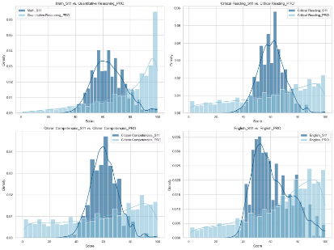
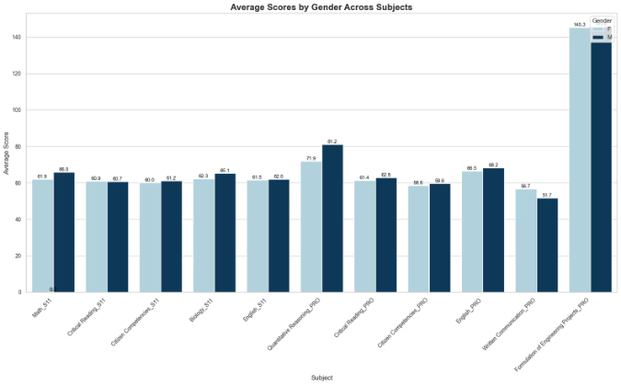
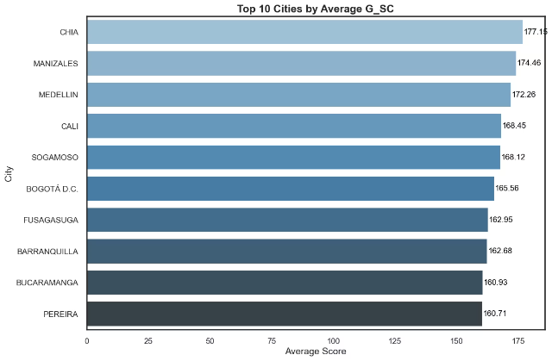
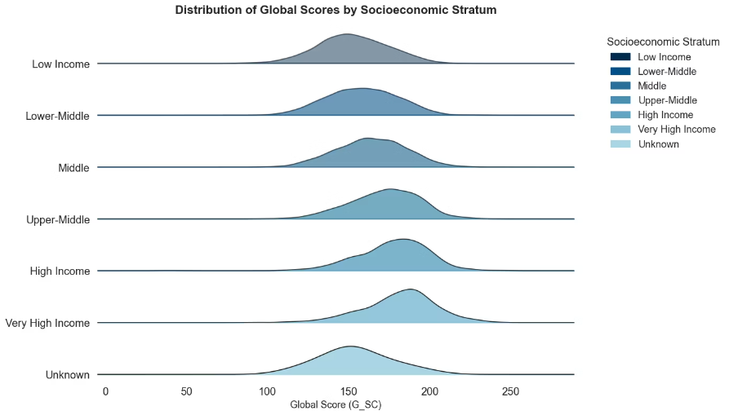
Exploratory Data Analysis (EDA)
Distribution of SABER 11 vs. SABER PRO Scores
Average Scores by Gender Across Subjects
The PRO versions consistently outperform the S11 versions across all categories, with noticeable peaks at higher score ranges
Females (F) consistently score higher than males (M) across all subjects, with the largest gap in Critical Reading_PRO at 145.3 for F versus 81.2 for M.
Top 10 Cities by Average Global score
Distribution of Global Scores by Socioeconomic Stratum
Chia leads the top 10 cities with the highest average global score at 177.15, while Pereira ranks lowest at 160.71.
Lower socioeconomic strata peak higher and narrower, while higher strata show broader, lower peaks.

Slide 6
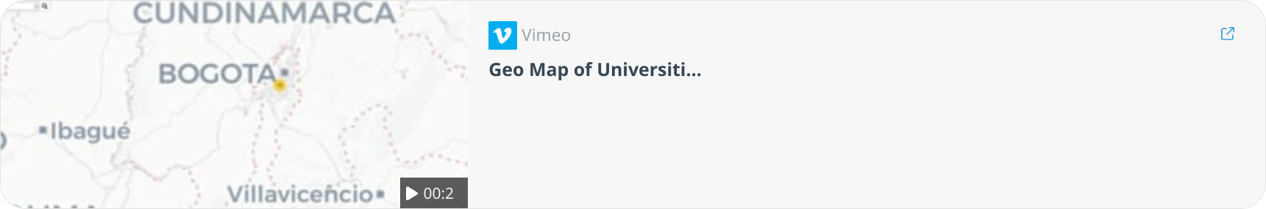
Geo Map of Universities by City
Used a geo map to visualize the location of universities across cities, highlighting the academic diversity and resources available.

Slide 7




Clustering Phase
Group students based on similar performance characteristics to uncover hidden patterns without using labels (unsupervised learning).
Method Used
Finding the Optimal K
We applied K-Means Clustering to segment students based on their saber11 and saber-pro scores
Used Elbow Method, Silhouette Score, and Calinski-Harabasz Index.
Optimal number of clusters was 2
Cluster Insights
Impact
Cluster 0: High-achieving students, likely college-ready, possibly from better-resourced schools.
Clustering helped us identify student groups for further efficiency analysis using TOPSIS.
Cluster 1: Students with potential but facing academic or structural challenges. Likely to benefit from targeted support.

Slide 8
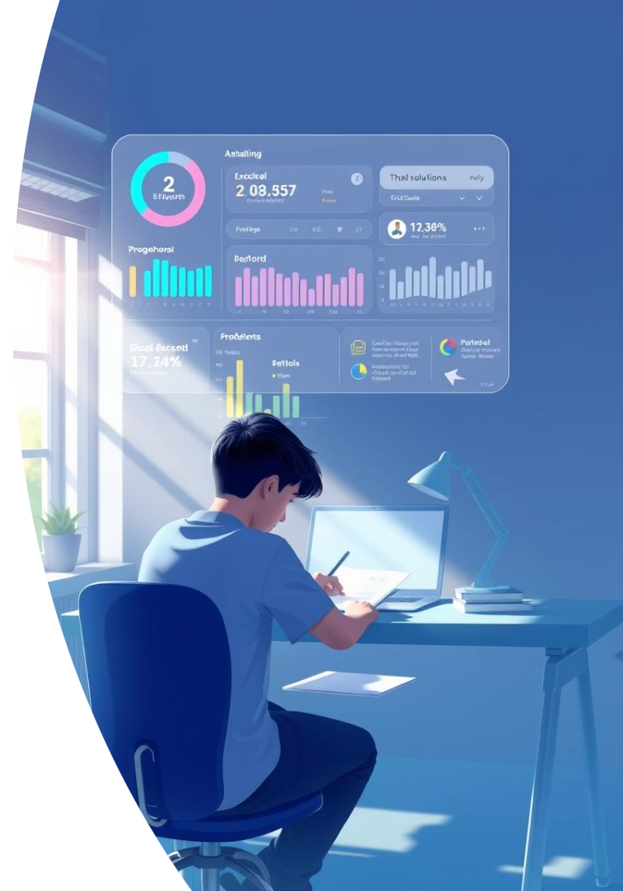
Efficiency Measurement with TOPSIS
TOPSIS Method (Technique for Order of Preference by Similarity to Ideal Solution)
Outcome
By setting a clear threshold, we labeled students into two classes: Efficient and Not Efficient. This binary label became the target variable for our classification models, making it possible to train, evaluate, and deploy a predictive system that supports data-driven student interventions.
evaluate student efficiency. It ranks students based on how close their performance is to an ideal student and how far it is from the worst case. This helped us identify which students achieved expected outcomes based on available resources.

Slide 9

Classification Phase
Predict whether a student is Efficient or Not Efficient based on the efficiency scores calculated by the TOPSIS method.
1
Approach
2
Models Tried
We formulated a binary classification task using the efficiency label (1 = Efficient, 0 = Not Efficient).
Logistic Regression
Random Forest Classifier
LightGBM Classifier
3
Model Evaluation
4
Best Performing Model
Used metrics like Accuracy, Precision, Recall, and F1-Score to evaluate each model.
Logistic Regression gave the best performance with balanced accuracy and no overfitting. Model selection was validated using MLflow for tracking and comparison.

Slide 10




Streamlit Deployment & Interactive Visualizations
Deployment Tool
We used Streamlit to deploy our classification model and present the project results in an interactive web application.
Key Features
User Input Form to test the efficiency prediction on new data.
Real-time Predictions using the best-trained model (Logistic Regression).
Interactive Visualizations to explore:
Score distributions
Clustering results
Efficiency comparisons across groups
Goal
Make the project accessible, explainable, and actionable for non-technical users like educators or decision-makers.

Slide 11
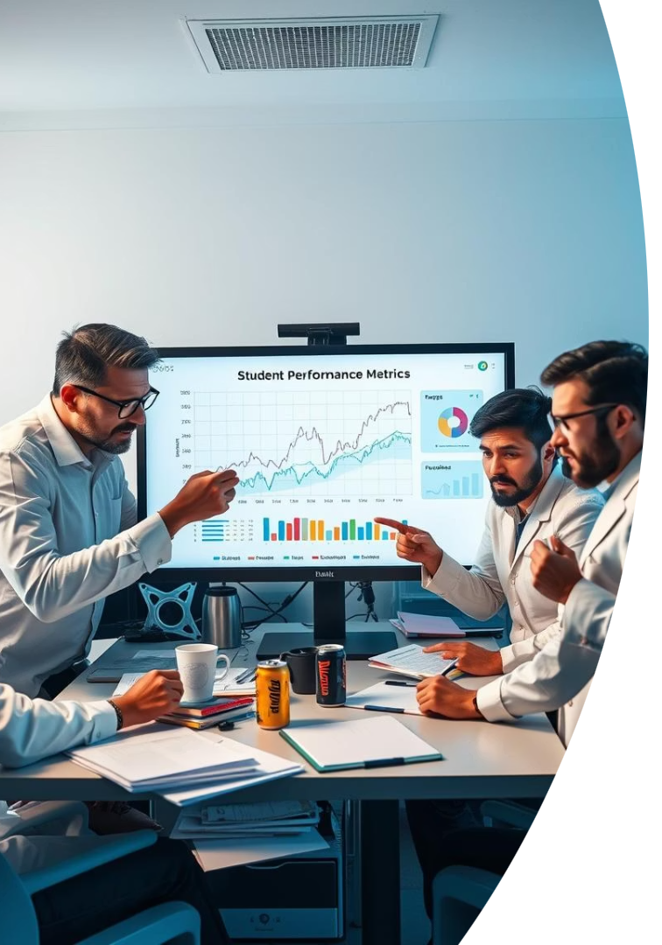
Obstacles We Faced
Unreliable Data
Our first dataset was synthetic and gave us unrealistic or contradictory insights, which delayed our progress.
Low Correlations
High school scores failed to predict university performance, making regression models ineffective.
Missing Context
Lack of key contextual features (like socio-economic status) limited our ability to build more accurate models
Approach Shift
We had to completely change our plan—moving from regression to clustering, then to classification.

Slide 12
Appendix & References
Tools included Python, scikit-learn, LightGBM, MLflow, and Streamlit for modeling and deployment.
Dataset Used
Research Paper Referenced
Colombian Engineering Students Dataset.
An Analysis of the Academic Performance of Colombian Engineering Students.

